Slide 1
Digital Logic Design
Imran Siddiqi
imran.siddiqi@mcs.edu.pk
Computer Science Department
College of Telecommunication Engineering
National University of Sciences and Technology

Slide 2
Next…
Analog versus Digital Systems
Digitization of Analog Signals
Binary Numbers and Number Systems
Number System Conversions
Representing Fractions

Slide 3
Representing Fractions
A number N_{r} in radix r can also have a fraction part:
N_{r} = d_{n-1}d_{n-2} … d₁d₀ . d₋₁ d₋₂ … d_{-m+1} d_{-m}
The number N_{r} represents the value:
N_{r} = d_{n-1} × r^{n-1} + … + d₁ × r + d₀ + (Integer Part)
d₋₁ × r ⁻¹ + d₋₂ × r ⁻² … + d_{-m} × r ^{–m} (Fraction Part)
0 ≤ d_{i} < r
Integer Part
Fraction Part
Radix Point

Slide 4
Examples of Numbers with Fractions
(2409.87)₁₀
(1101.1001)₂
(703.64)₈
(A1F.8)₁₆
(423.1)₅
(263.5)₆
= 2×10³ + 4×10² + 9 + 8×10⁻¹ + 7×10⁻²
= 2³ + 2² + 2⁰ + 2⁻¹ + 2⁻⁴ = 13.5625
= 7×8² + 3 + 6×8⁻¹ + 4×8⁻² = 451.8125
= 10×16² + 16 + 15 + 8×16⁻¹ = 2591.5
= 4×5² + 2×5 + 3 + 5⁻¹ = 113.2
Digit 6 is NOT allowed in radix 6

Slide 5
Converting Decimal Fraction to Binary
Convert N = 0.6875 to Radix 2
Solution: Multiply N by 2 repeatedly & collect integer bits
Stop when new fraction = 0.0, or when enough fraction bits are obtained
Therefore, N = 0.6875 = (0.1011)₂
Check (0.1011)₂ = 2⁻¹ + 2⁻³ + 2⁻⁴ = 0.6875
Multiplication | New Fraction | Bit
0.6875 × 2 = 1.375 | 0.375 | 1
0.375 × 2 = 0.75 | 0.75 | 0
0.75 × 2 = 1.5 | 0.5 | 1
0.5 × 2 = 1.0 | 0.0 | 1
First fraction bit
Last fraction bit

Slide 6
More Conversion Examples
Convert N = 139.6875 to Octal (Radix 8)
Solution: N = 139 + 0.6875 (split integer from fraction)
The integer and fraction parts are converted separately
Therefore, 139 = (213)₈ and 0.6875 = (0.54)₈
Now, join the integer and fraction parts with radix point
N = 139.6875 = (213.54)₈
Division | Quotient | Remainder
139 / 8 | 17 | 3
17 / 8 | 2 | 1
2 / 8 | 0 | 2
Multiplication | New Fraction | Digit
0.6875 × 8 = 5.5 | 0.5 | 5
0.5 × 8 = 4.0 | 0.0 | 4

Slide 7
Conversion Procedure to Radix r
To convert decimal number N (with fraction) to radix r
Convert the Integer Part
  Repeatedly divide the integer part of number N by the radix r and save the remainders. The integer digits in radix r are the remainders in reverse order of their computation. If radix r > 10, then convert all remainders > 10 to digits A, B, … etc.
Convert the Fractional Part
  Repeatedly multiply the fraction of N by the radix r and save the integer digits that result. The fraction digits in radix r are the integer digits in order of their computation. If the radix r > 10, then convert all digits > 10 to A, B, … etc.
Join the result together with the radix point

Slide 8
Simplified Conversions
Converting fractions between Binary, Octal, and Hexadecimal can be simplified
Starting at the radix pointing, the integer part is converted from right to left and the fractional part is converted from left to right
Group 4 bits into a hex digit or 3 bits into an octal digit
Use binary to convert between octal and hexadecimal
integer: right to left
fraction: left to right
7
2
6
1
3
.
2
4
7
4
5
2
Octal
1
1
1
0
1
0
1
1
0
0
0
1
0
1
1
.
0
1
0
1
0
0
1
1
1
1
0
0
1
0
1
0
1
Binary
7
5
8
B
.
5
3
C
A
8
Hexadecimal

Slide 9
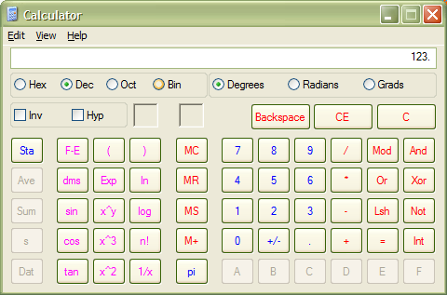
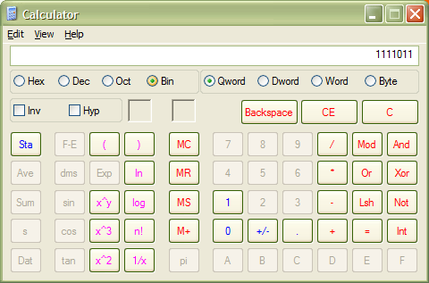
Windows Calculator for Binary
1. Type your number.
3. See new value.
2. Choose notation.

Slide 10
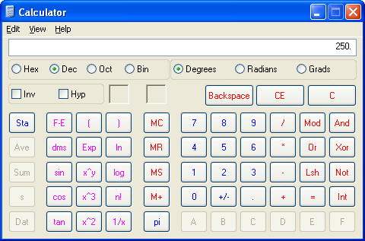
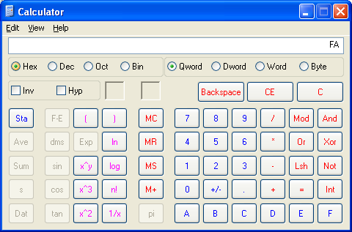
Windows Calculator for Hex
1. Type your number.
3. See new value.
2. Choose notation.

Slide 11
There are 10 types of people in the world... Those who understand binary, and those who don’t.

Slide 12
Arithmetic -- addition
Binary similar to decimal arithmetic
No carries
1 | 0 | 1 | 1 | 0 | 0
 | 1 | 0 | 1 | 1 | 0
+ | 1 | 0 | 1 | 1 | 1
No carries
Carries
 | 0 | 1 | 1 | 0 | 0
+ | 1 | 0 | 0 | 0 | 1
1 | 1 | 1 | 0 | 1
1 | 0 | 1 | 1 | 0 | 1
1+1 is 2 (or 10₂), which results in a carry

Slide 13
Arithmetic -- subtraction
No borrows
 | 0 | 0 | 1 | 1 | 0
 | 1 | 1 | 1 | 1 | 0
- | 1 | 0 | 0 | 1 | 1
Borrows
 | 1 | 0 | 1 | 1 | 0
- | 1 | 0 | 0 | 1 | 0
0 | 0 | 1 | 0 | 0
 | 0 | 1 | 0 | 1 | 1
0 - 1 results in a borrow
Borrow makes it (10)₂ ₌(2) ₁₀

Slide 14
Arithmetic -- multiplication
 |  | 1 | 0 | 1 | 1
 | X |  | 1 | 0 | 1
 |  | 1 | 0 | 1 | 1
 | 0 | 0 | 0 | 0
1 | 0 | 1 | 1
1 | 1 | 0 | 1 | 1 | 1

Slide 15
Complements
Conventional addition (using carry) is easily implemented in digital computers.
However; subtraction by borrowing is difficult and inefficient for digital computers
Much more efficient to implement subtraction using ADDITION of the COMPLEMENTS of numbers

Slide 16
Complements
Subtraction by addition
  R’s Complement
    In Binary 2’s complement
    In Decimal 10’s complement
  (R-1) Complement
    In Binary 1’s complement
    In Decimal 9’s Complement

Slide 17
Diminished Radix (r-1) Complement
Given a number N in base r having n digits, its r-1 complement is
Decimal: (10^{n} -1 ) - N
  If n=6 then 10⁶-1=1000000-1=999999
  9’s complement of 546700 is 999999-546700=453299
  In simple words subtract each digit from 9
(r^{n} -1 )-N

Slide 18
Diminished Radix (r-1) Complement
9’s Complement
9
9
9
9
9
9
Find the 9’s complement of 546700 and 12389
-
5
4
6
7
0
0
4
5
3
2
9
9
The 9’s complement of 546700 is 999999 - 546700= 453299
And the 9’s complement of 12389 is
99999- 12389 = 87610.
9
9
9
9
9
-
1
2
3
8
9
8
7
6
1
0

Slide 19
Diminished Radix (r-1) Complement
1’s Complement
Binary: (2^{n} -1 )-N
  If n=4 then 2⁴= (16)₁₀= (10000)₂
  2^{4 –} 1 = (15)₁₀= (1111)₂
  Note: 1-0=1 and 1-1 =0 (Bit Changes)
  In simple words just change the bits

Slide 20
Diminished Radix (r-1) Complement
1’s Complement
1
1
1
1
1
1
1
-
1
0
1
1
0
0
1
The complement 1’s of
1011001 is 0100110
0
1
0
0
1
1
0
1
1
1
1
1
1
1
-
0
0
0
1
1
1
1
The 1’s complement of
0001111 is 1110000
1
1
1
0
0
0
0

Slide 21
Radix (r) Complement
Given a number N in base r having n digits, its r complement is
Simply add one to the radix-1 complement
  (r^{n} –N) = [(r^{n} -1 )-N] +1
(r^{n} –N)

Slide 22
Radix (r) Complement
10’s Complement
Find the 10’s complement of 546700 and 12389
The 10’s complement of 546700 is 1000000 - 546700= 453300
and the 10’s complement of 12389 is
100000 - 12389 = 87611.
1
0
0
0
0
0
0
-
5
4
6
7
0
0
4
5
3
3
0
0
1
0
0
0
0
0
-
1
2
3
8
9
8
7
6
1
1
Notice that it is the same as 9’s complement + 1.

Slide 23
Radix (r) Complement
2’s Complement
1
0
0
0
0
0
0
0
-
The 2’s complement of
1011001 is 0100111
1
0
1
1
0
0
1
0
1
0
0
1
1
1
1
0
0
0
0
0
0
0
-
The 2’s complement of
0001111 is 1110001
0
0
0
1
1
1
1
1
1
1
0
0
0
1

Slide 24
Fast Computation of 2’s Complement
Method 1:
The 2’s complement of binary number is obtained by adding 1 to the l’s complement value.
Example:
1’s complement of 101100 is 010011 (invert the 0’s and 1’s)
2’s complement of 101100 is 010011 + 1 = 010100

Slide 25
Fast Computation of 2’s Complement
Method 2
The 2’s complement can be formed by leaving all least significant 0’s and the first 1 unchanged, and then replacing l’s by 0’s and 0’s by l’s in all other higher significant bits.
Example:
The 2’s complement of 1101100 is
0010100
Leave the two low-order 0’s and the first 1 unchanged, and then replacing 1’s by 0’s and 0’s by 1’s in the four most significant bits.

Slide 26
Subtraction with r-Complement
Subtract N from M : M – N
r’s complement of N = r^{n} – N
Add M to ( r^{n} – N ); Result = M + ( r^{n} – N)
if M ≥ N, simply ignore the carry
if M < N, take the r’s complement of sum and place negative sign in front of sum. The answer is negative.

Slide 27
Example 1
Perform the subtraction 72532 - 13250 = 59282.
M > N : Case 1 Discard carry
The 10’s complement of 13250 is 86750.
Therefore:
M = 72532
10’s complement of N =+86750
Sum= 159282
Discard end carry 10⁵= - 100000
Answer = 59282

Slide 28
Example 2
Now consider an example with M <N.
The subtraction 13250 - 72532 produces negative 59282. Using the procedure with complements, we have
M = 13250
10’s complement of N = +27468
Sum = 40718
Take 10’s complement of Sum = 100000
-40718
The number is : 59282
Place negative sign in front of the number: -59282

Slide 29
References
Chapter 1 – Digital Design Morris Mano
Digital Logic and Computer Design – M. Singh, University of North Carolina
Digital Design – O. Ozturk, Bilknet University
Material in these slides has been taken from, the following resources

